Slide 1
Rate card flow in Right Price 2.0 Application
20th February,2019

Slide 2
Table of Contents
Introduction:
Right Price 2.0 portal is an enhanced version of the existing Right Price application with new, improvised additional features. The purpose or intent of the document is to capture to be functionality and overall flow of the application. The intent of new portal is to create an application with better User interface, maintainable application with performance improvements.
Table of Contents:
The document is exclusively meant for Atos Syntel Employees having valid Syntel credentials belonging to either Delivery, GFT, BU Head, CDO, CEO Delivery Head or CEO Office.

Slide 3
Table of Contents
Below are the screens available under Rate card Menu:
Rate Card Creation – Details
Role Selection
Role Selection – Contractor Roles
Role Utilization And Rates
Summary
Finalize Rate Card

Slide 4
Table of Contents
Rate cards module shall allow the Delivery team to create new Rate Cards for all those customers, which the logged in user has access to and belonging to the logged in user’s Vertical. Below are the several combinations in which the Rate Cards can be created.
Automatic
Manual
Hybrid
KPO

Slide 5
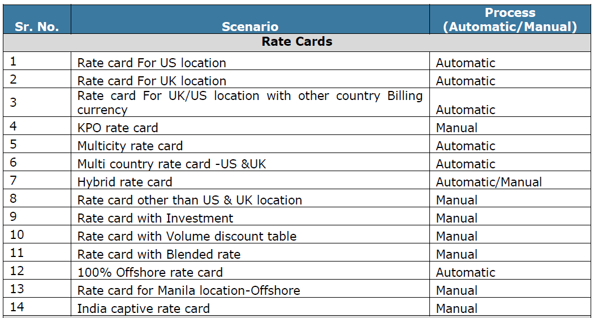
Table of Contents

Slide 6
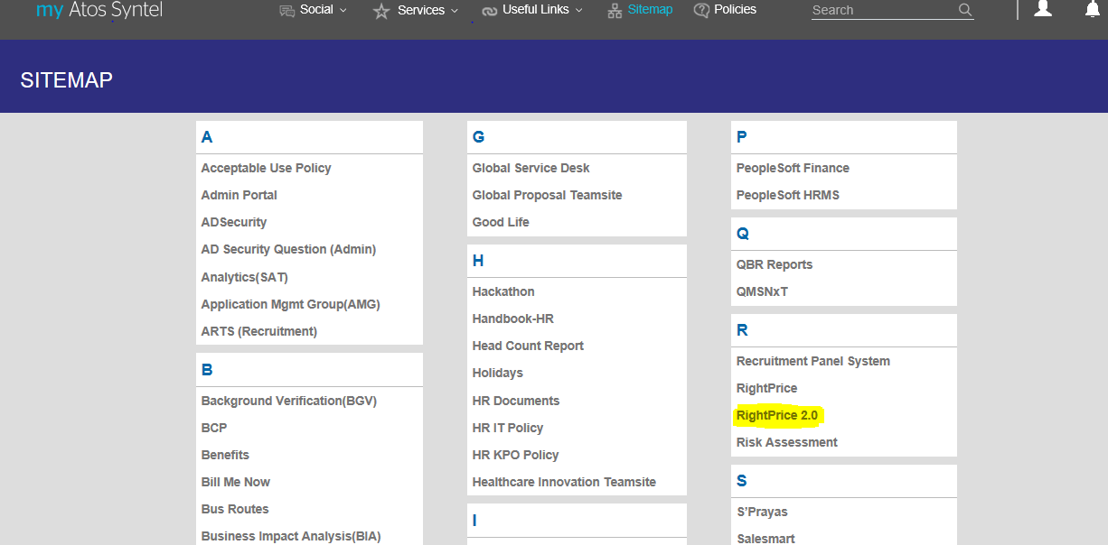
Delivery Log In
Right Price (RP) 2.0 is available on My Atos-Syntel platform. Below is the screen of RP 2.0 menu under Sitemap highlighted & is common screen in all users login.

Slide 7
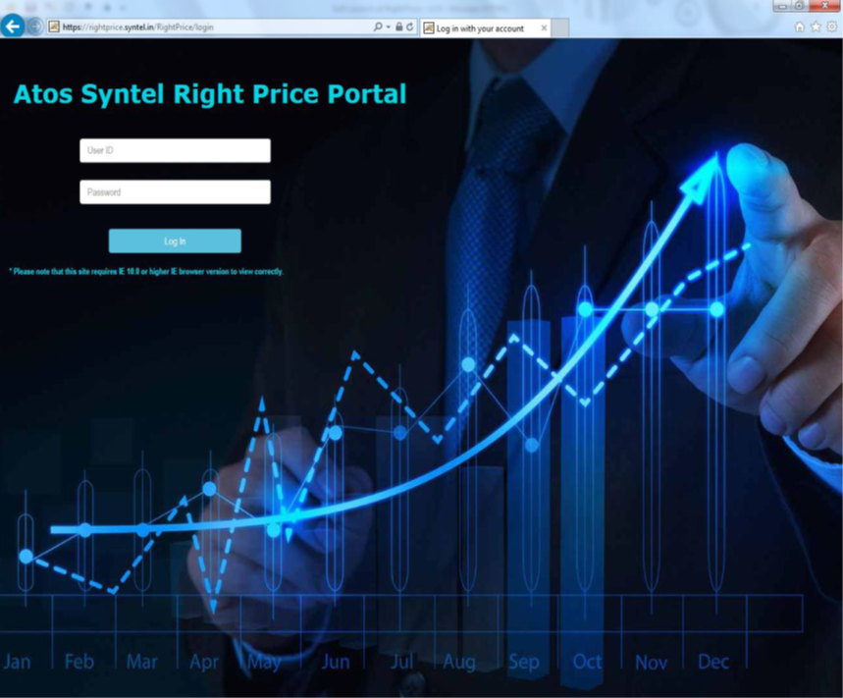
Delivery Log In
A link in myAtosSyntel is provided to access Right Price 2.0 portal. This link in turn will redirect the user to Login screen of the portal. User will have to enter valid Atos Syntel credentials to access the Portal. If user logins to Right Price portal by accessing the link in myAtosSyntel, irrespective of the login credentials entered in myAtosSyntel, user will still need to enter the credentials to access Right Price 2.0 portal.

Slide 8
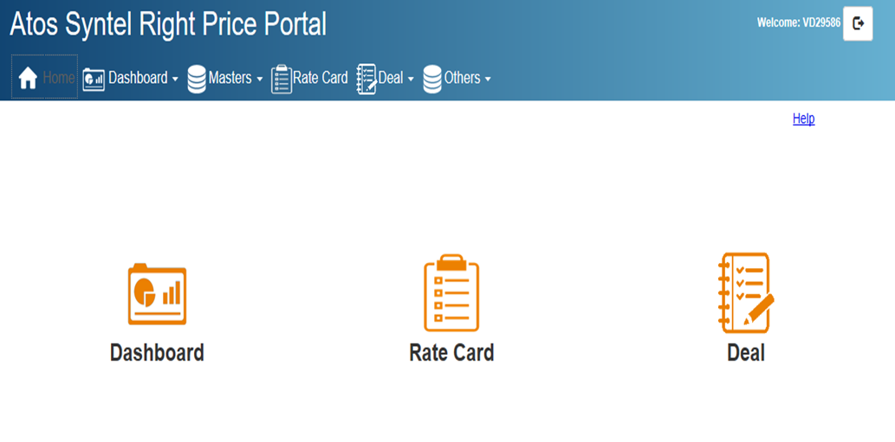
Creation of Rate card– Automatic/System
Following screen appears on User Screen after login

Slide 9
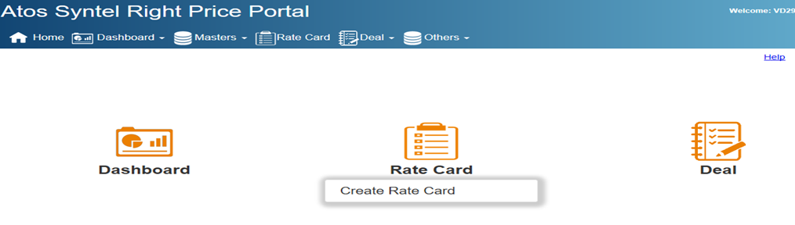
Rate card Screen
Step1: For creation of new RC card User has to click on Rate card as shown in screen below

Slide 10
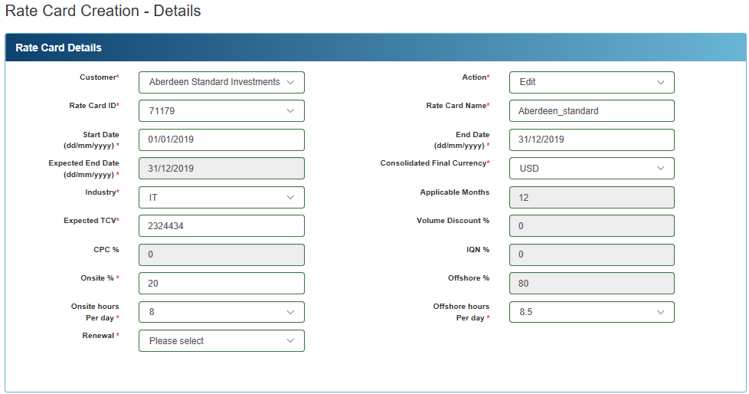
Rate card Creation Page
Step2: Rate card Creation Page appears where User has to fill below details

Slide 11
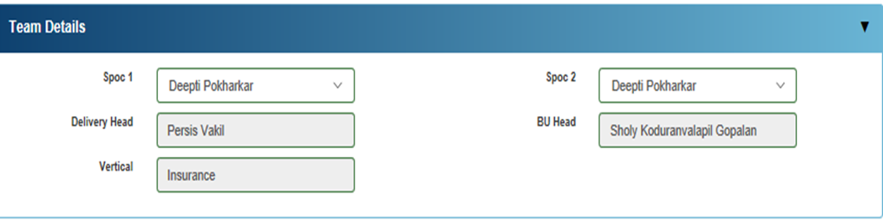
Rate card Delivery Team details
Step3: User has to update the Delivery team details on below screen

Slide 12
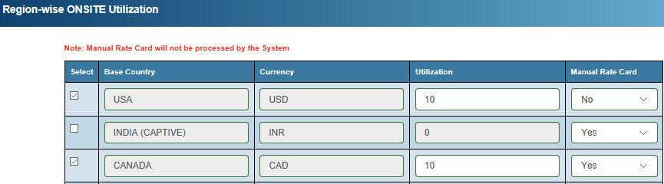

Region wise Onsite Utilization –Hybrid Rate card
Step4: User has to update Country wise Onsite Utilization & under Manual Rate card tab select “NO” as highlighted below wherever applicable to generate Automatic & Manual Rate card

Slide 13
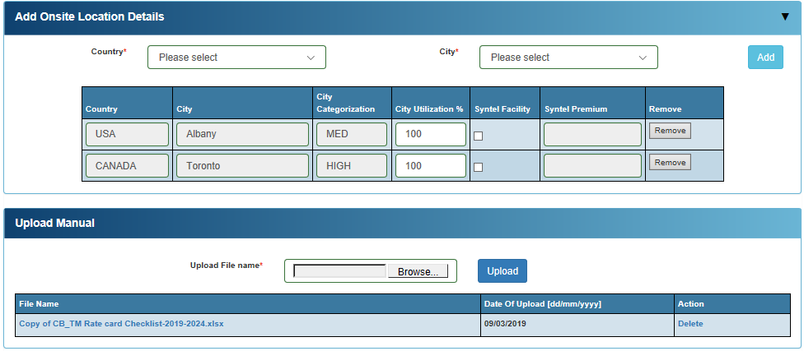
Onsite Location Detail- Hybrid Rate card
Step5: User has to update Onsite Location details- Select Onsite Country, Select City & Fill City Utilization details & then Click on Add
User will have to upload Manual checklist for Manual Rate card

Slide 14
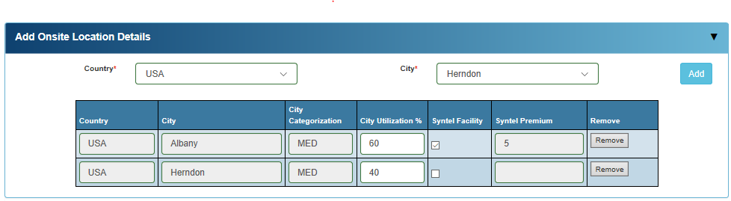
Onsite Location Detail- Hybrid Rate card
Note: User can also Select Syntel Facility as well as Client Facility within same country for which User has to select two city as shown below & update the City Utilization %.
If Syntel Facility is selected a premium of $5 will be added in Master rates & same has to be added in proposed rates.

Slide 15
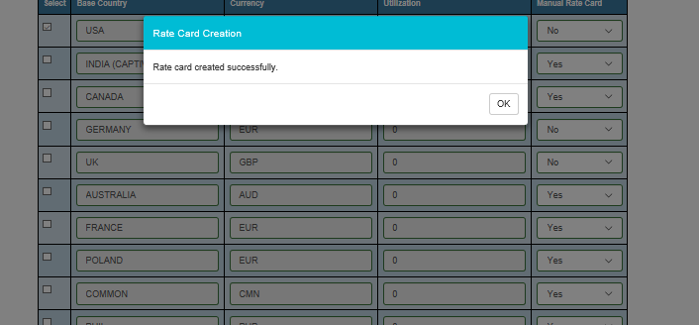
Onsite Location submission
Step6 : Once User update the Onsite details & save the data following screen appears

Slide 16
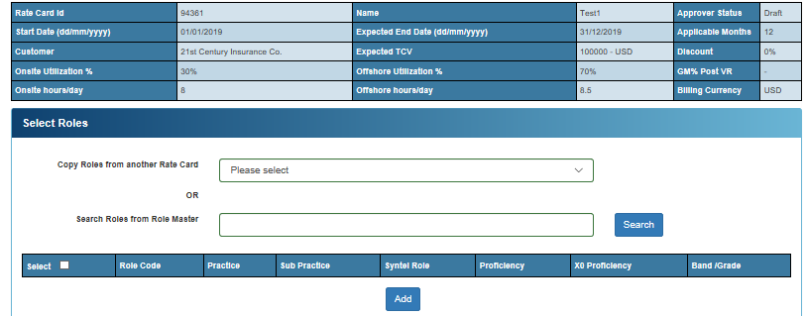
Role Selection- Hybrid Rate card
Step7 : After successful creation of Rate card next screen appears for Role Selection. User can select roles from either Existing RC or from Master roles as shown in screen below.

Slide 17
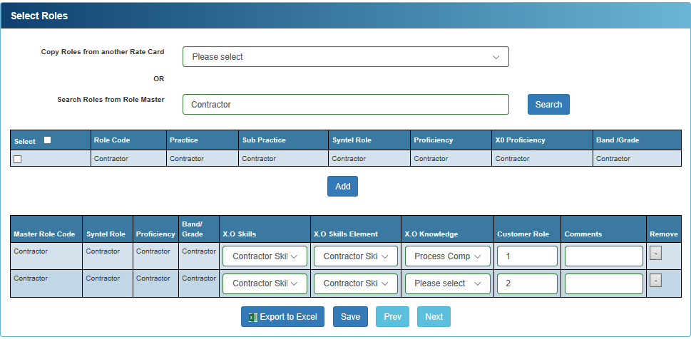
Role Selection – Contractor roles
Note: User can also Select Contractor as show in below screen & update the roles & skills if applicable & click on Save.

Slide 18
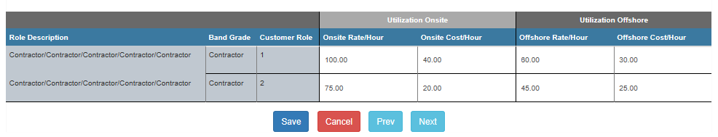
Role Selection – Contractor roles
In the below screen for Contractor roles user has to fill Bill rate per hour & Cost per hour & Click on Save to arrive the contractor role wise margin

Slide 19
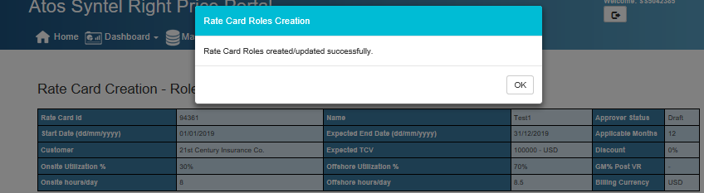
Role Selection submission- Contractor Roles
Once the Contractor roles selection is done Click on Save button. Following Screen appears " Rate card Roles created Successfully“

Slide 20
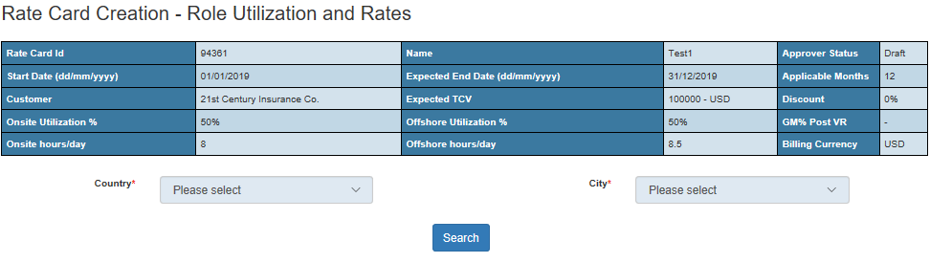
Role Utilization & Rates
.
Note: In case of single country and single city the role details table shall be displayed automatically when the screen is loaded. In case of multi country and multicity, user needs to select the Country and City and then click on Search button as shown below. Offshore shall be enabled for only one city. The country for which utilization percentage is higher, and the city for which utilization percentage is higher that shall be considered for offshore

Slide 21
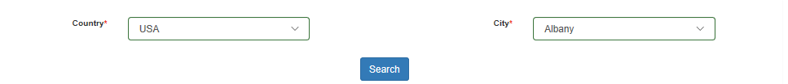
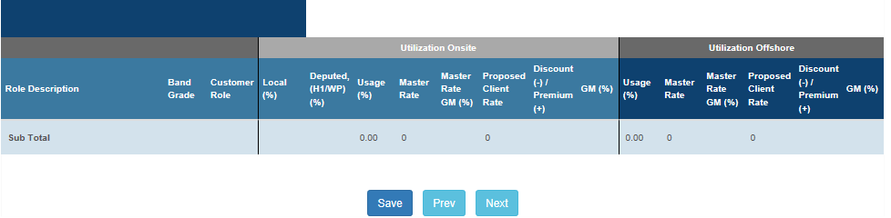
Role Utilization & Rates- Hybrid Rate card
Step8: User have to select Country & City for Automatic Rate card as shown in below screen & then click on Search.

Slide 22
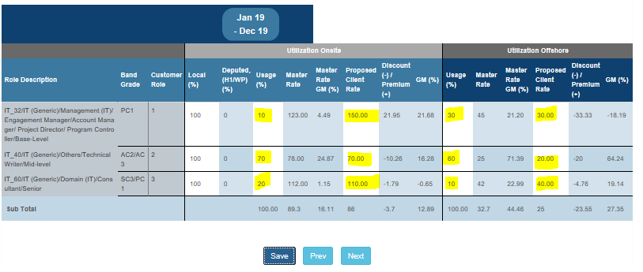
Role Utilization & Rates- Hybrid Rate card
Step9 : This screen user has to enter the role utilization and rates against the Roles for Automatic Rate card & then Click on Save
Update Local/Deputed Utilization
Onsite/Offshore Utilization
Proposed Onsite & Offshore Rates

Slide 23
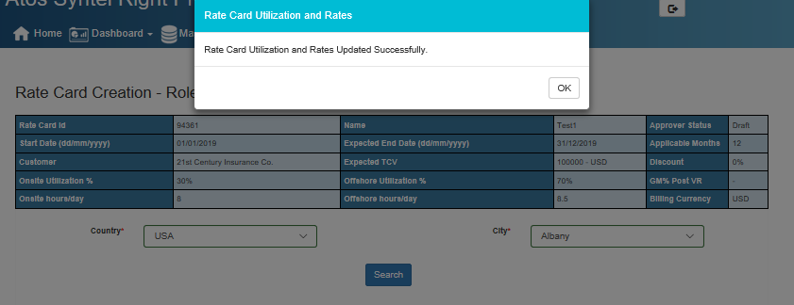
Role Utilization & Rates Submission-Hybrid Rate card
Step10 : Once the Utilization & Proposed Rates are filled click on Save button. Following Screen appears " Rate card Utilization & Rates submitted Successfully"

Slide 24
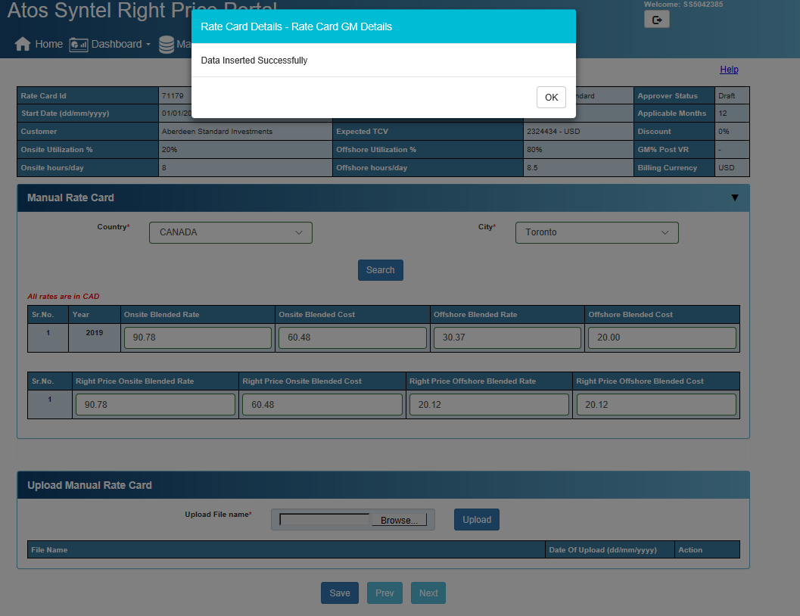
Manual Rate card upload file- Hybrid Rate card
Step11: For Manual Rate card user has to fill Blended Rate & Blended Cost & Click on Save & upload the Rate card file & Click on Save

Slide 25
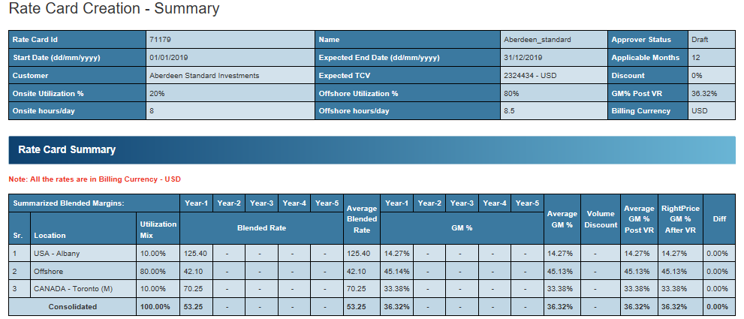
Rate Card Summary - Hybrid Rate card
Step12: Below screen display the Summary details Year wise & Country wise. User can view the Location wise GM & Consolidate GM & Click on Next

Slide 26
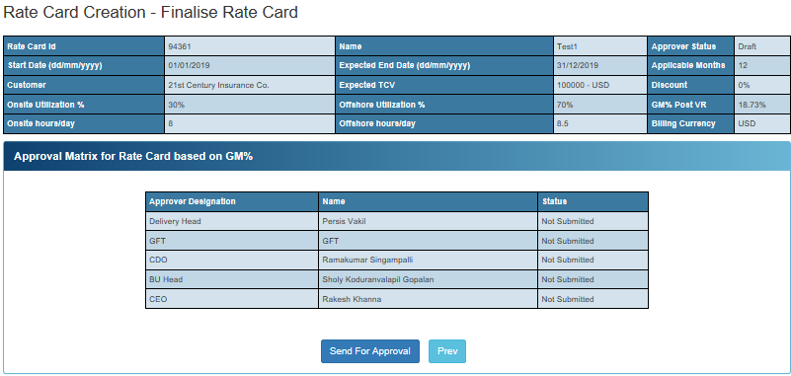
Finalize Rate card
Step12: This screen displays the sequential flow of the approver matrix. User needs to click on Send for Approval to initiate the approval flow. Based on approval matrix rate card will flow to next level of approval. All rate card has to be approved by BUH & CDO & where Gross GM is less then 35% it has to be approved by CEO

Slide 27
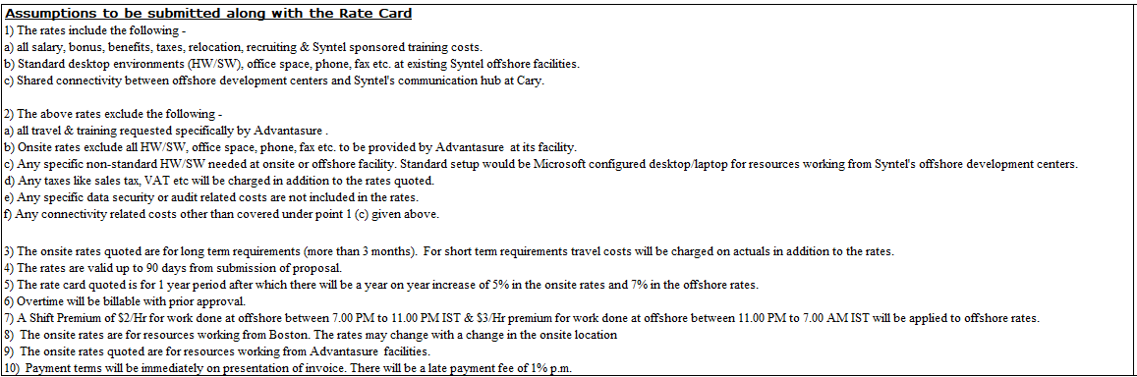
Assumptions on Rate card

